Slide 1

Concrete Strength Prediction Using Linear Regression
17 June, 2025
Predicting the strength of concrete using linear regression model
By Team 6:
Saurav Raj Aryal
Shanti Tamang
Manjil Shrestha
1

Slide 2
Project Goal
EDA
Perform EDA to obtain clean dataset
Feature Engineering
Use feature engineering to add and remove features
Predict Strength
Estimate concrete compressive strength
2

Slide 3
Machine Learning Process Flow Diagram
Data profiling analysis and cleaning
Feature Engineering
Visualization
Handling Outliers
Linear Regression
Findings
3

Slide 4
Data Overview & Preprocessing
Initial Samples
1030
Features
9
Null Values
0
Duplicates Removed
25 (2.4%)
Unique Records
1005
4

Slide 5
Exploratory Data Analysis (EDA)
Histograms
Heatmap
Reveal feature distributions, e.g., cement content is skewed.
Shows correlation matrix; cement highly correlated with strength.
Boxplots
Identify potential outliers in various concrete components.
5

Slide 6
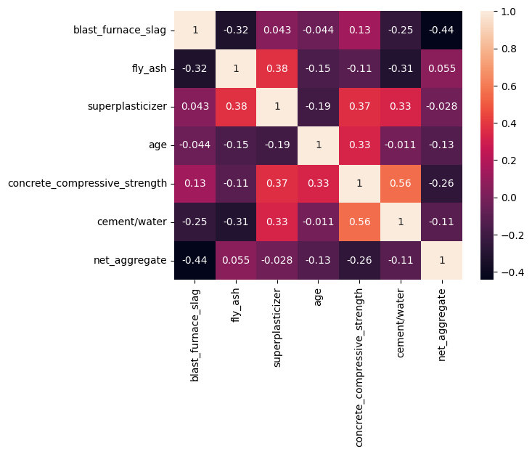
HEAT MAP
Concrete strength is highly correlated to cement/water ratio
6

Slide 7




Feature Engineering
Cement/Water Ratio
Cement amount / Water amount
Net Aggregate
Coarse Aggregate + Fine Aggregate
Improved Interpretability
Made model insights clearer.
7

Slide 8
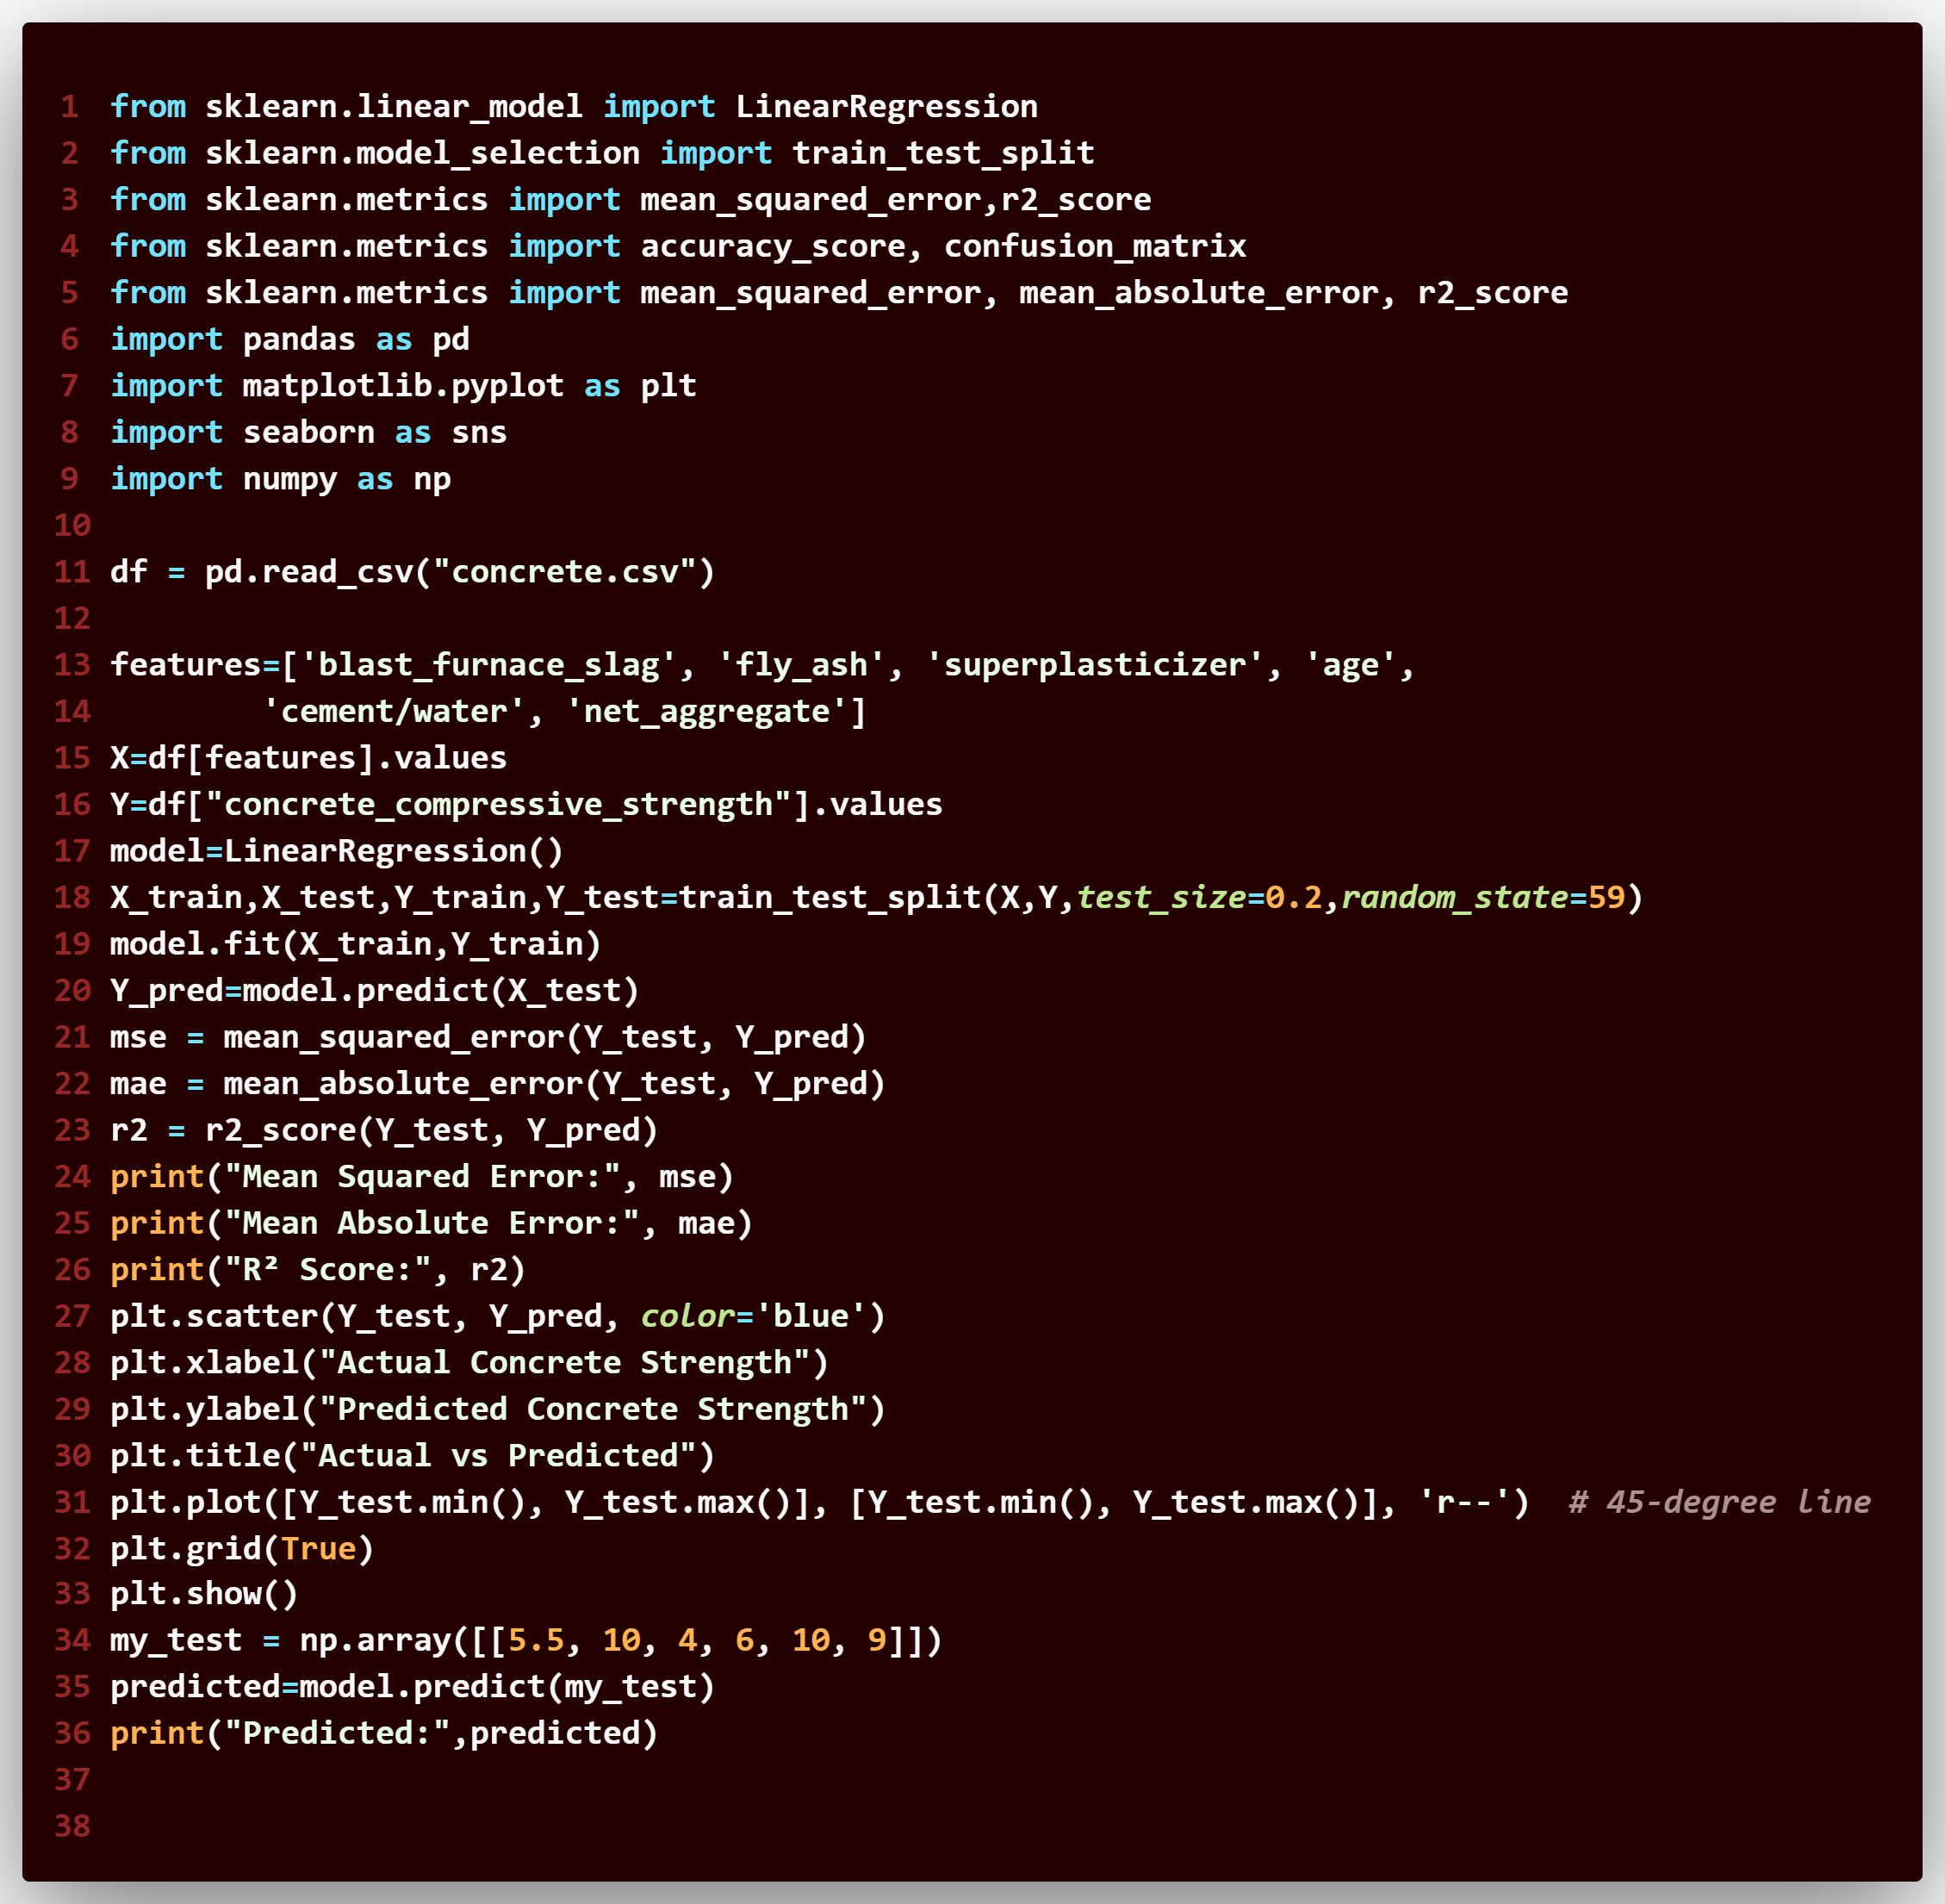

Machine Learning Code
8

Slide 9


Model Development & Performance
Model Type
Linear Regression
Data Split
80% training, 20% testing data.
Baseline Model : 59% accuracy with 8.6 mean absolute error
Fine Tuned Model:
GridSearchCV
59% accuracy with 8.7 mean absolute error
9

Slide 10




Key Findings
Ratio & Strength
Higher ratio correlates with increased strength.
Cement Impact
High influence on strength.
Cement-Water Ratio
Most significant predictor for strength.
Superplasticizer
Also highly influential.
2
3
1
4
10

Slide 11
Conclusion
Proper EDA was done
Data was visualized properly
Feature Engineering was done
Outliers were handled
Model was trained
59% accuracy was obtained by both baseline and fine_tuned model
11

Slide 12

Body Fat Classification Using Logistic Regression
This project focuses on predictive modeling to classify individuals into body fat categories using the bodyweight.csv dataset.
12

Slide 13
Project Goal & Classification
Objective
Classification Criteria
Features
Predict body composition: Lean, Muscular, or Fat
Lean
Slightly Fat
14 measurements used as features
Muscular
Average
Obese
Fat
13

Slide 14
Data Preparation: Ensuring Quality
1
Dataset Overview
bodyweight.csv: 252 entries, 15 features
2
Null Values
Zero missing entries confirmed
3
Duplicate Records
No duplicate rows identified, ensuring unique data points
4
Data Types
All features correctly parsed as numeric
The result is a clean, ready-to-use dataset for subsequent analysis and model training.
14

Slide 15
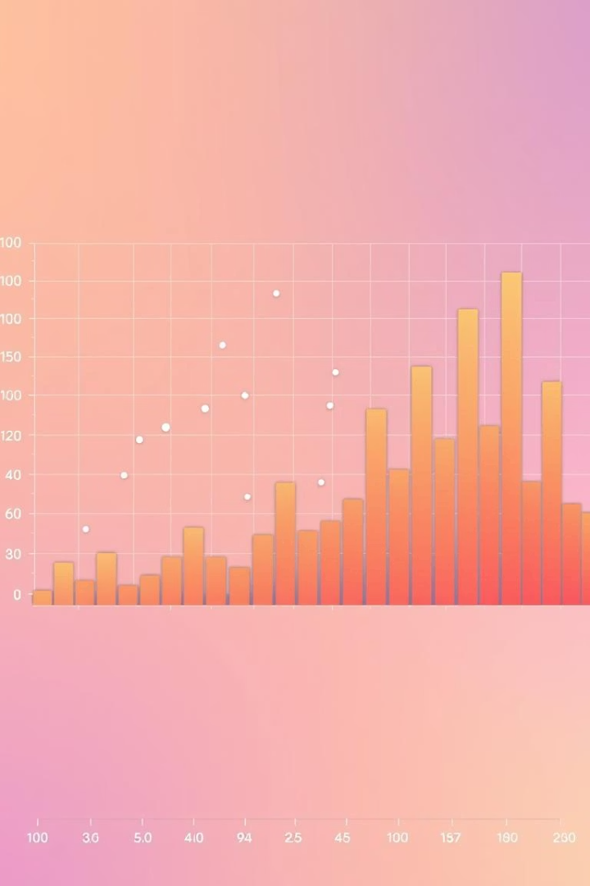
Exploratory Data Analysis: Distributions
Histograms
Heat Map
Visualized relationships between highly correlated features
Age: relatively uniform across dataset
15

Slide 16
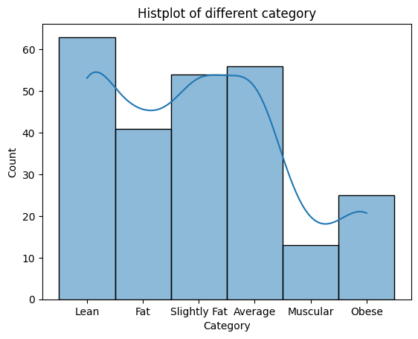
Histogram
Majority of the data is of lean whereas muscular has minimum
16

Slide 17
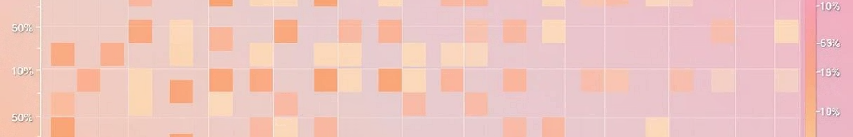


Exploratory Data Analysis: Correlations & Outliers
Correlation Heatmap
Strong positive correlation with weight
Decision
Outliers retained as representative of extreme body types
17

Slide 18

Model Implementation & Performance
Model Type
Logistic Regression
Features Used
14 anthropometric measurements
Data Split
80% Training, 20% Testing (stratified)
Overall Accuracy
60% on test set
Conclusion
Accuracy considered reasonable for baseline model
18

Slide 19
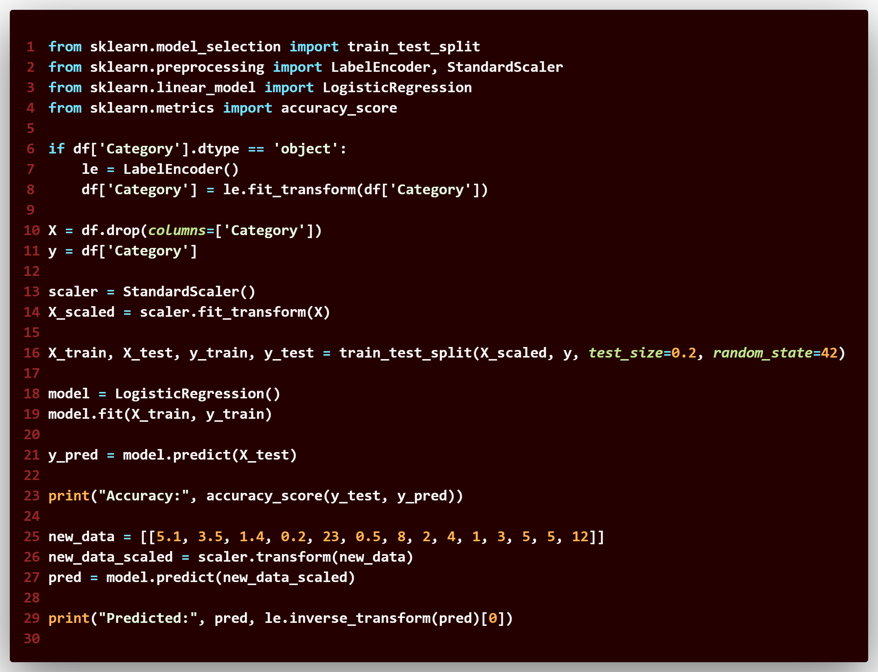
Machine Learning Code
19

Slide 20


Model Development
Baseline Model
Logistic Regression provides a solid initial system
60% accuracy indicates significant potential for improvement
Fine Tuned Model
Logistic Regression with hyperparameter have an accuracy of 50%, less than baseline but yet it can be considered ok
GridSearchCV
20

Slide 21



Key Findings from Model
Predictive Power
2
'Abdomen circumference' & 'Weight' were most influential
Class Distribution
'Lean' category most prevalent (45% of dataset)
Followed by 'Chest' & 'Hip circumference'
1
'Muscular/Average' (35%), 'Fat' (20%)
Misclassifications
Highest error rate: distinguishing 'Muscular' from 'Fat' individuals
3
The model successfully captures general trends in body fat classification.
21

Slide 22
DEPLOYMENT USING STREAMLIT
Streamlit is an open-source Python library that allows developers and data scientists to easily create interactive web applications for machine learning and data analysis.
Deployment using Streamlit refers to the process of:
Building a web app using Python and Streamlit scripts.
Running it locally using streamlit run your_app.py.
Deploying it online, for example:
Using Streamlit Community Cloud (free hosting).
Or platforms like Render, Heroku, AWS, etc.
Streamlit makes deployment simple — you just write Python code, and it turns into a live, user-friendly app without needing HTML, CSS, or JavaScript.
22

Slide 23
THANK YOU
23

